Slide 1
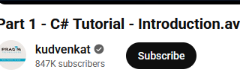
Kudvenkat
https://www.youtube.com/watch?v=SXmVym6L8dw&list=PLAC325451207E3105

Slide 2
CameraKit Walkthrough
https://github.com/JohnRowleyDorsetCollege2025/oop-2025-camera-rental-20251111.git

Slide 3
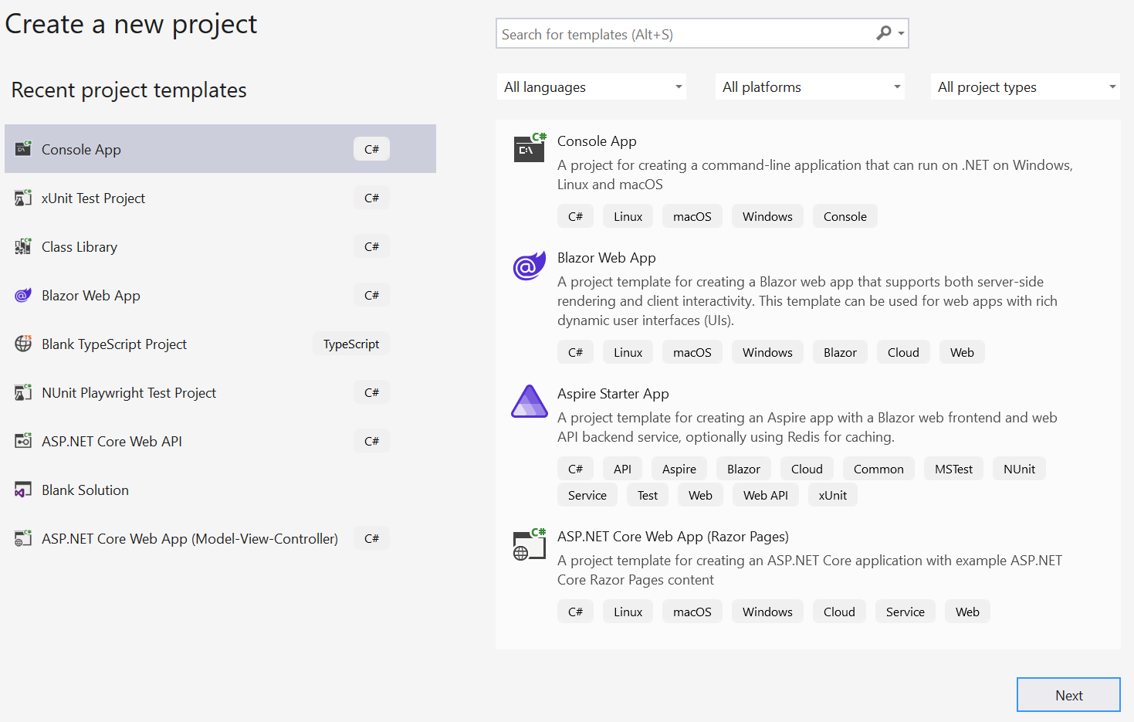

Slide 4
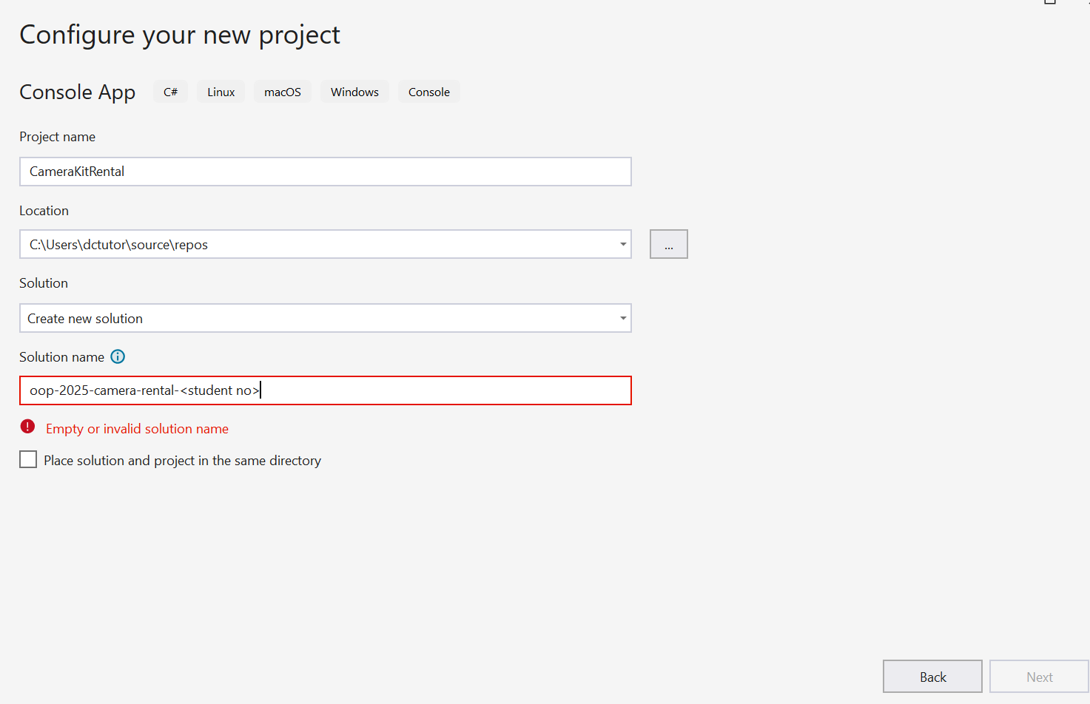

Slide 5
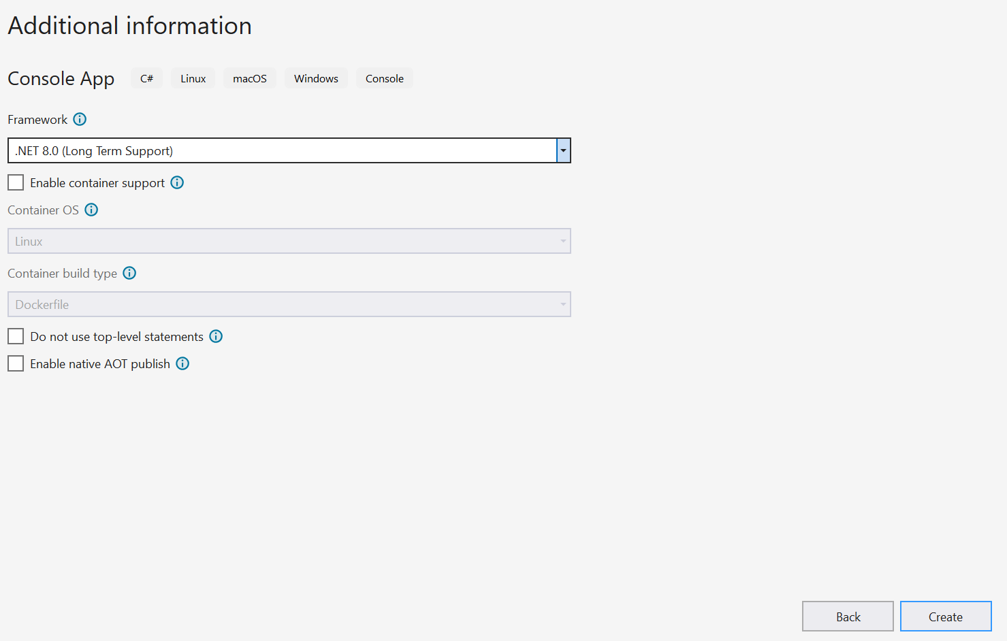

Slide 6
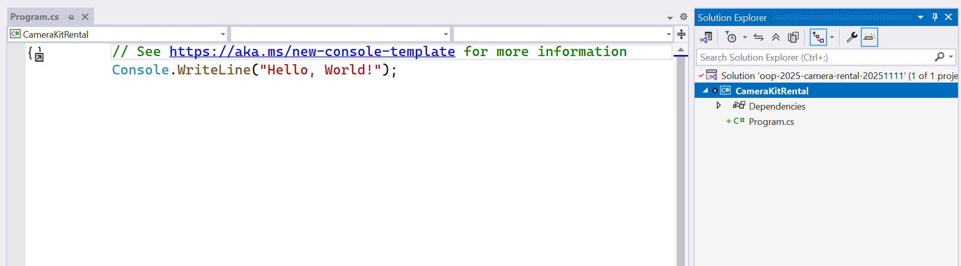

Slide 7
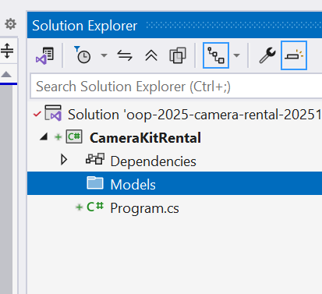
Create New Folder

Slide 8
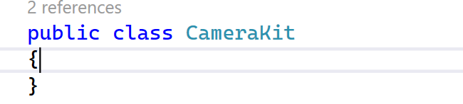
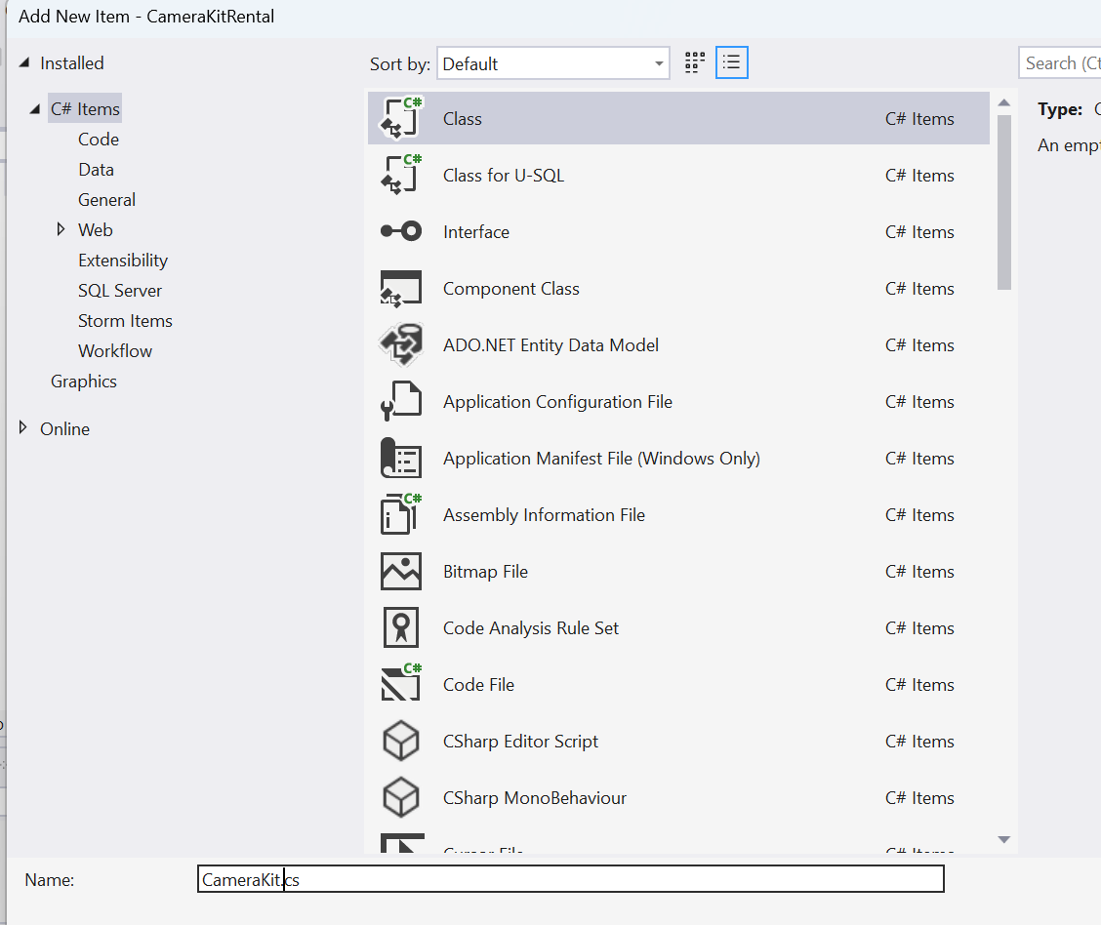

Slide 9
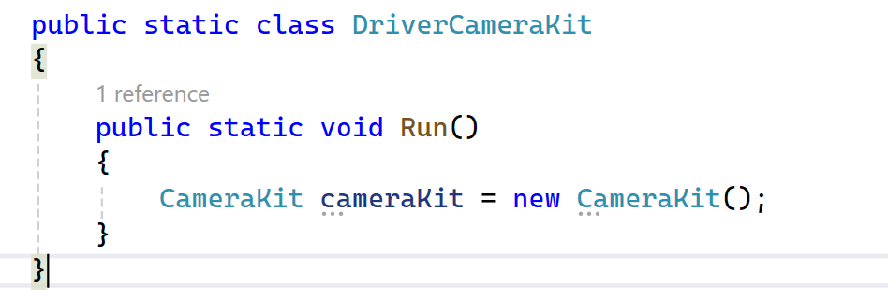

Slide 10
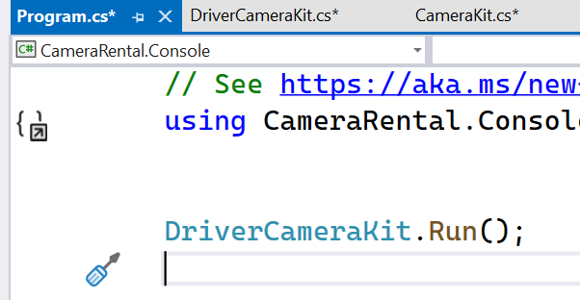

Slide 12
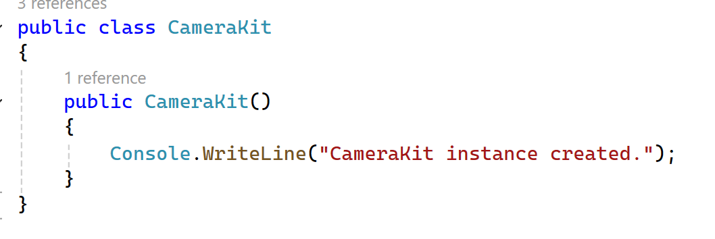
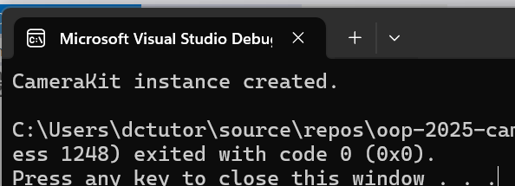
constructor (no parameters)

Slide 13
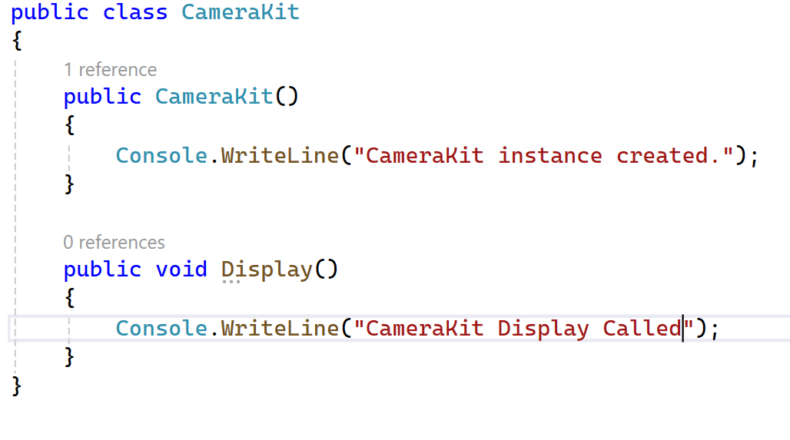
Constructors do not declare a return value
Void indicates no value returned

Slide 14
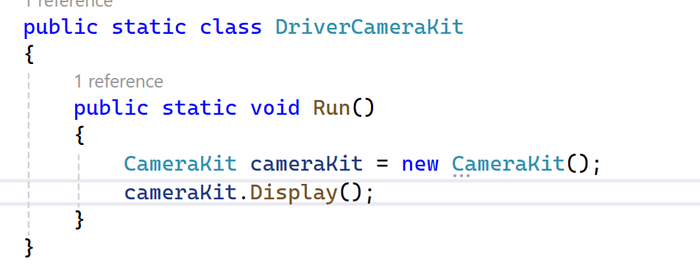
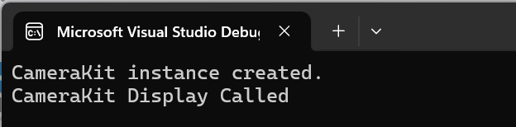

Slide 15
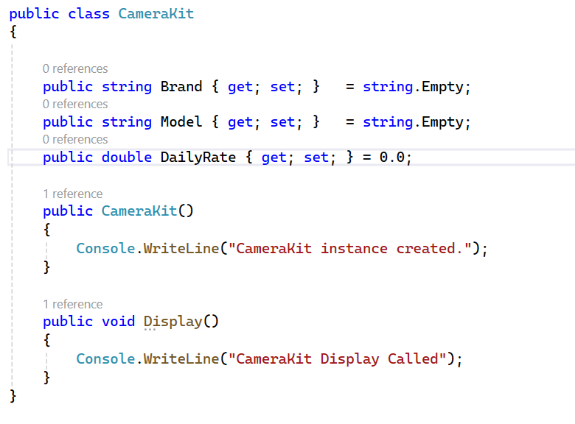

Slide 16
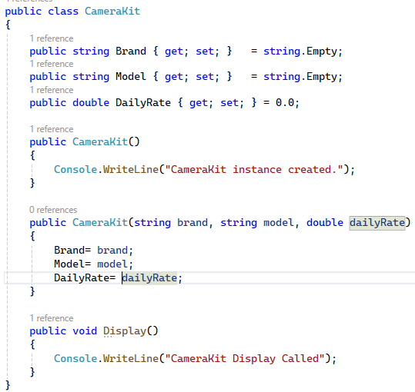
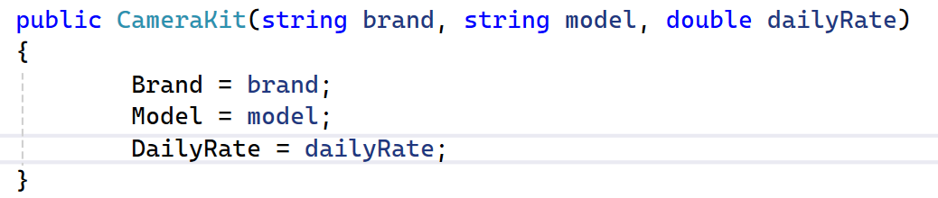
Constructors have different ‘signatures’ depending on number and type of parameters

Slide 17
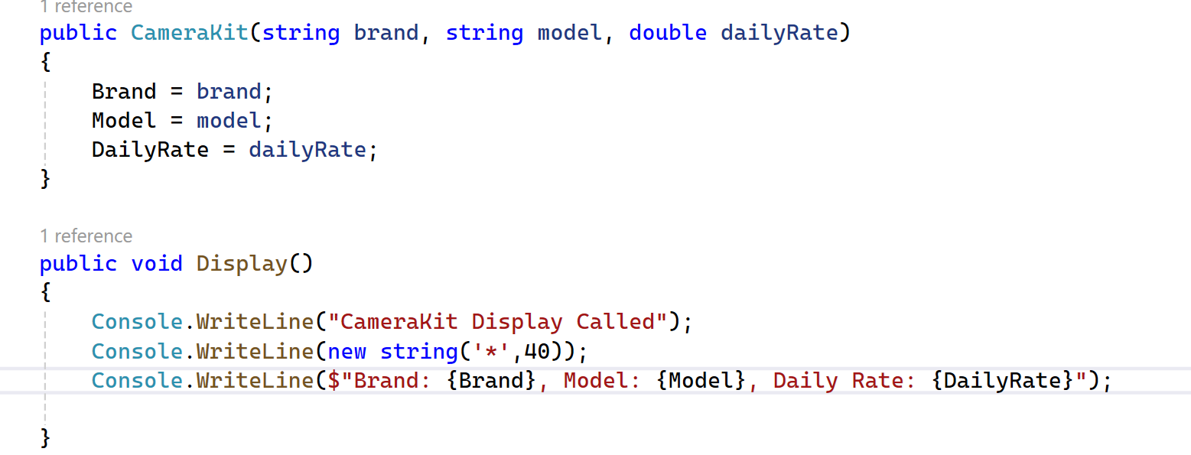

Slide 18
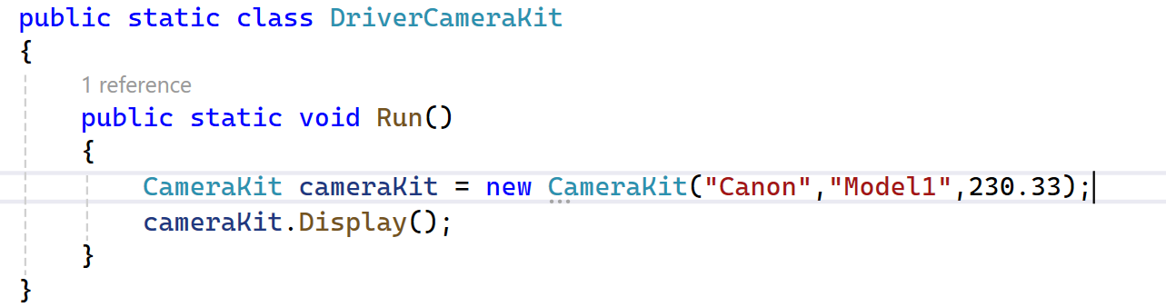

Slide 19
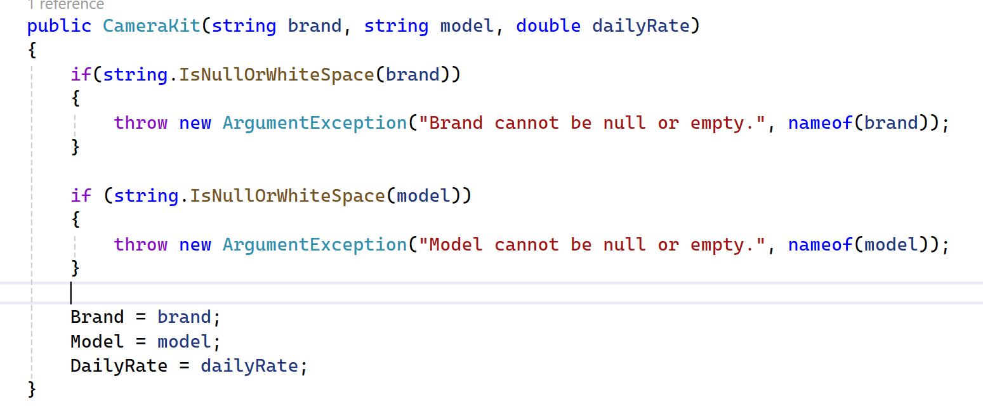

Slide 20
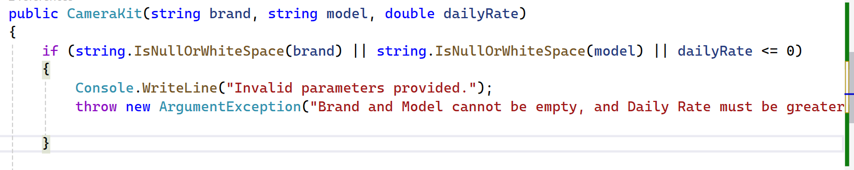

Slide 21
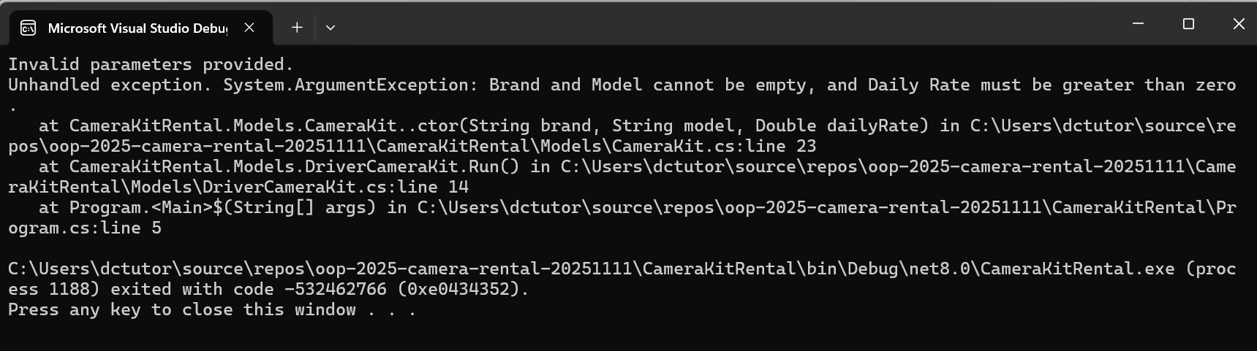
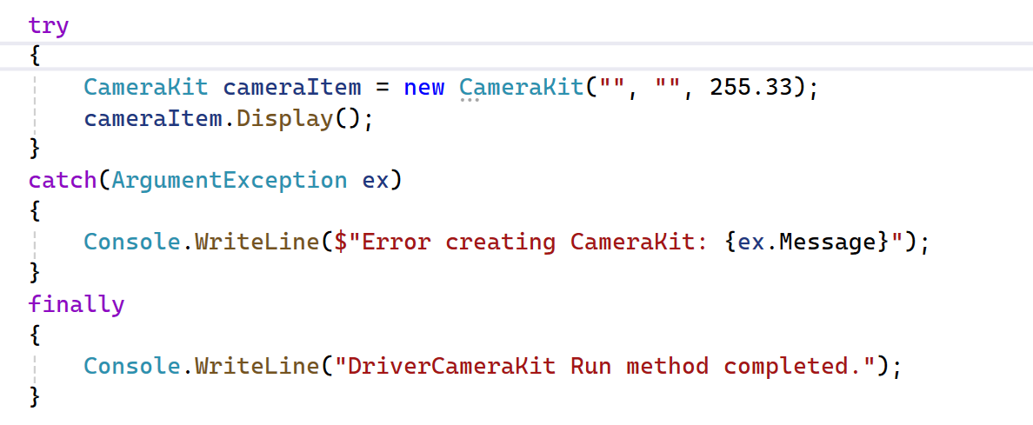

Slide 22
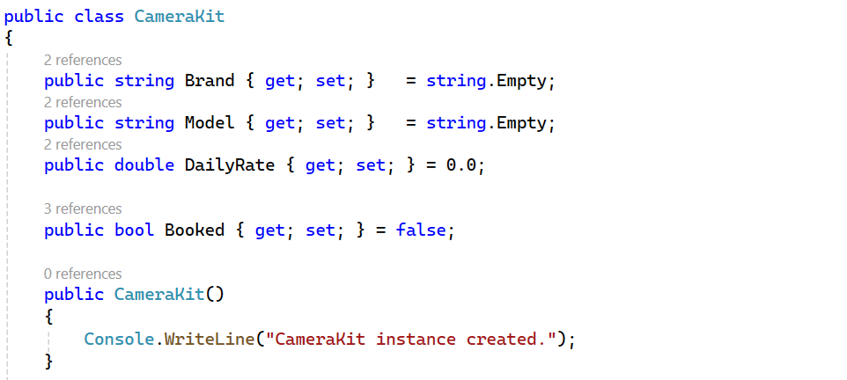

Slide 23
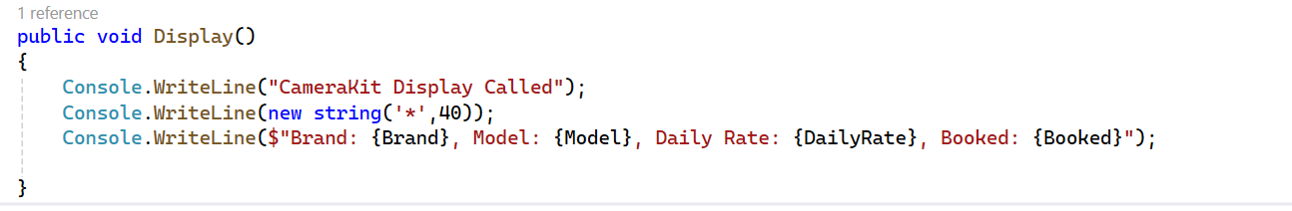

Slide 24

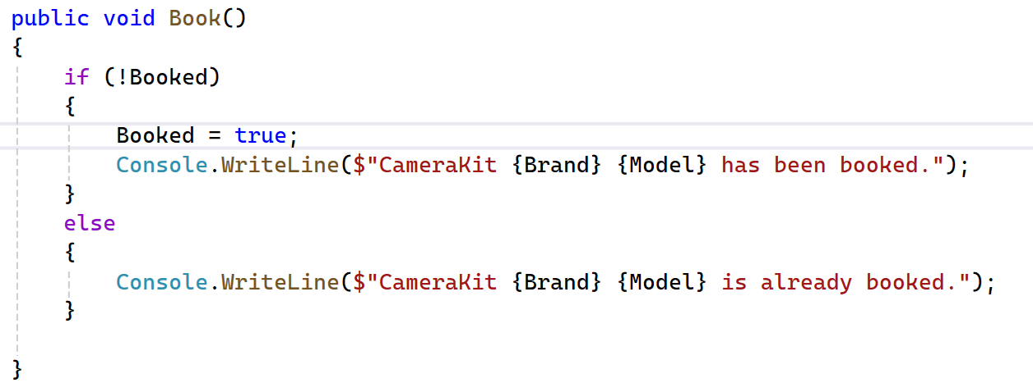

Slide 25
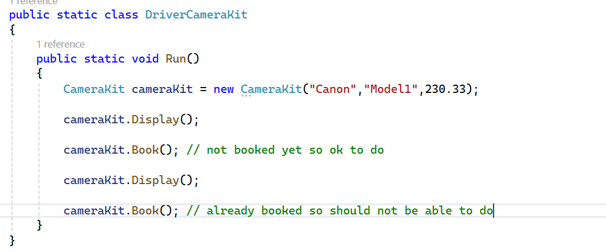
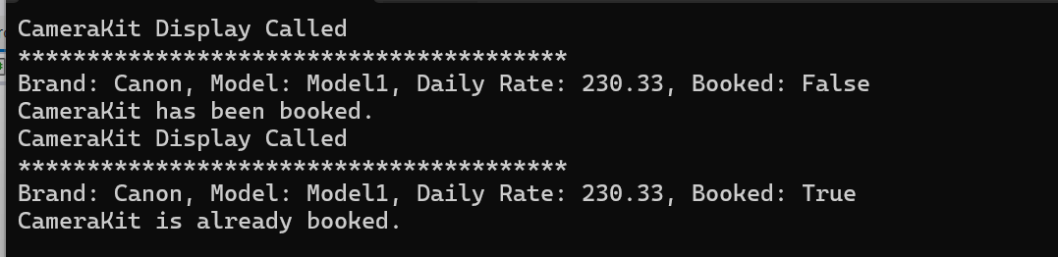

Slide 26
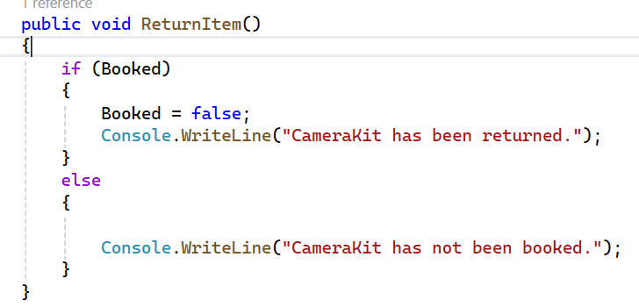

Slide 27
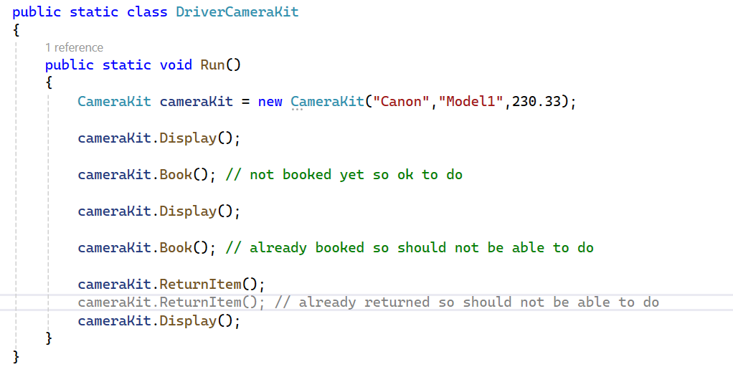

Slide 28
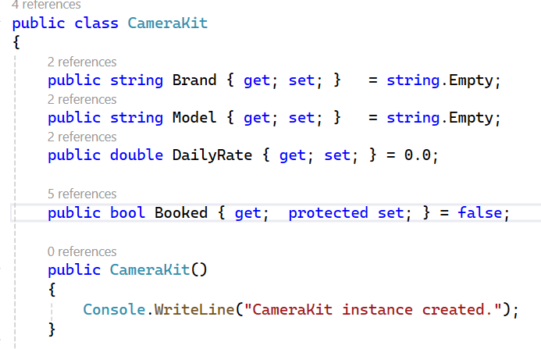

Slide 29
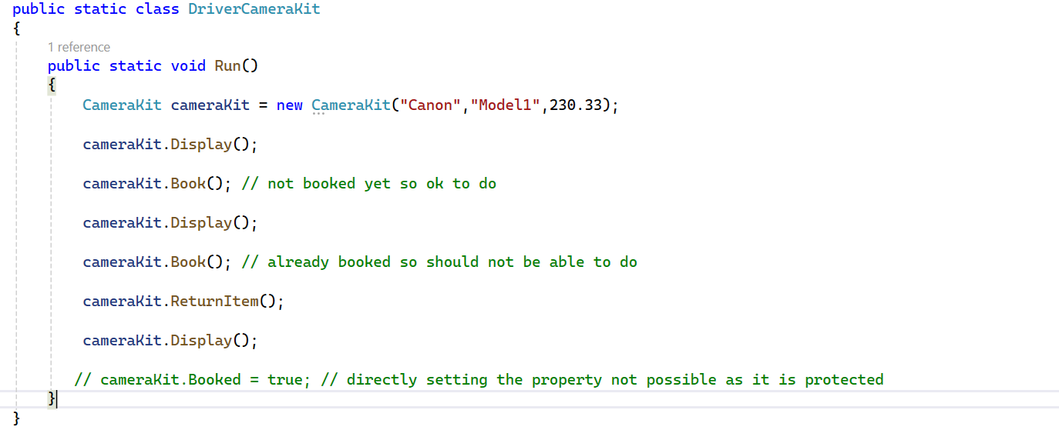

Slide 30
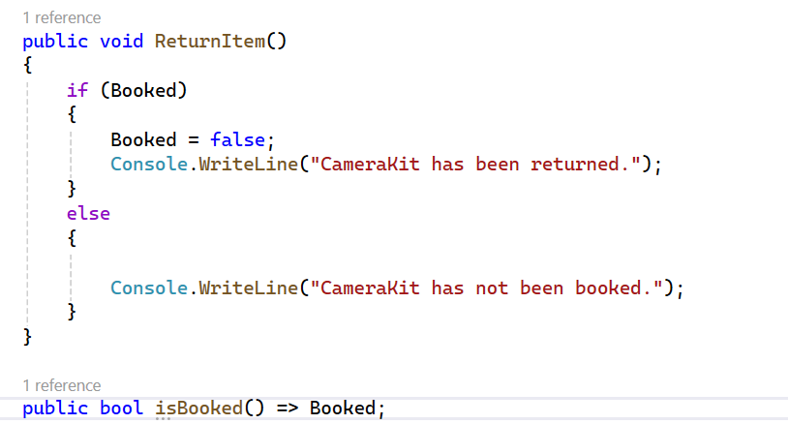

Slide 31
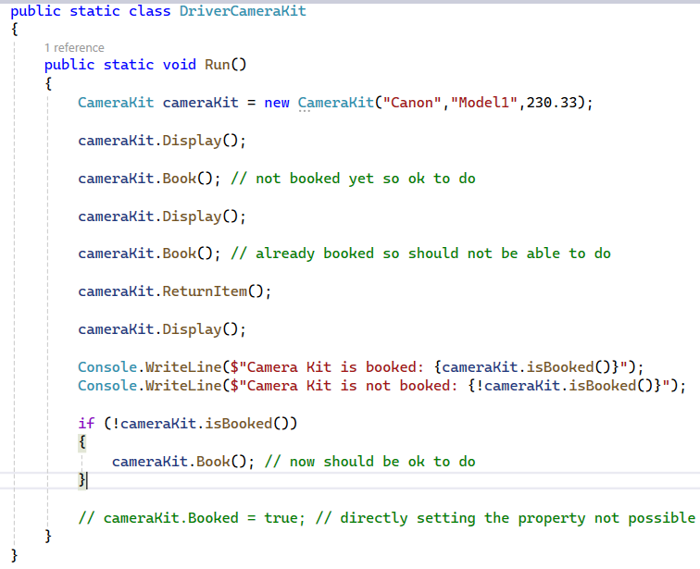

Slide 32
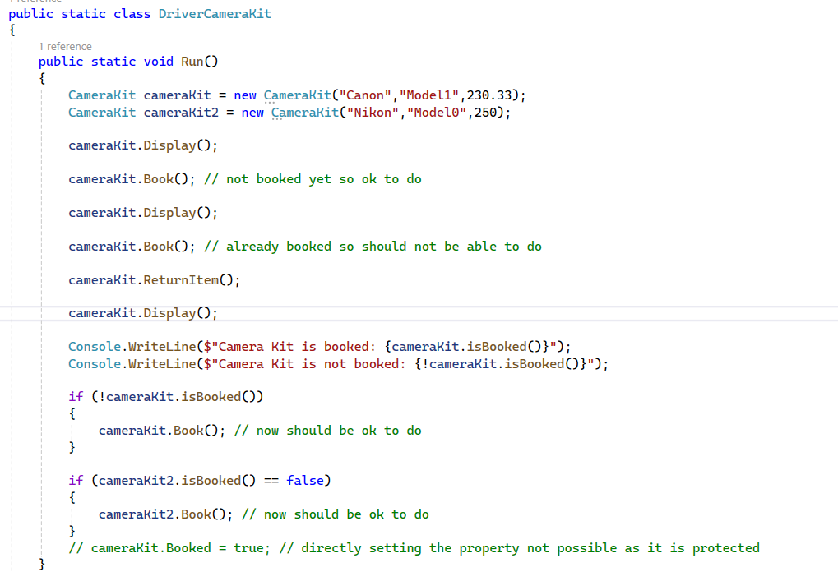

Slide 33
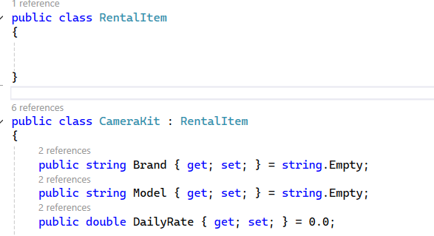

Slide 34
Interfaces, abstract classes

Slide 35
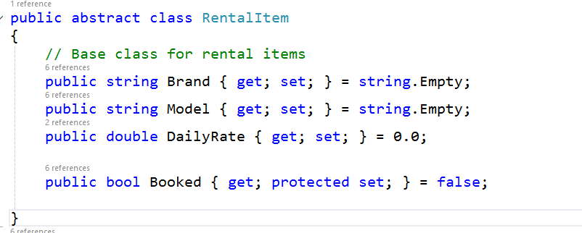
1
2
Move these properties out of CameraKit and up into Rental Item

Slide 36
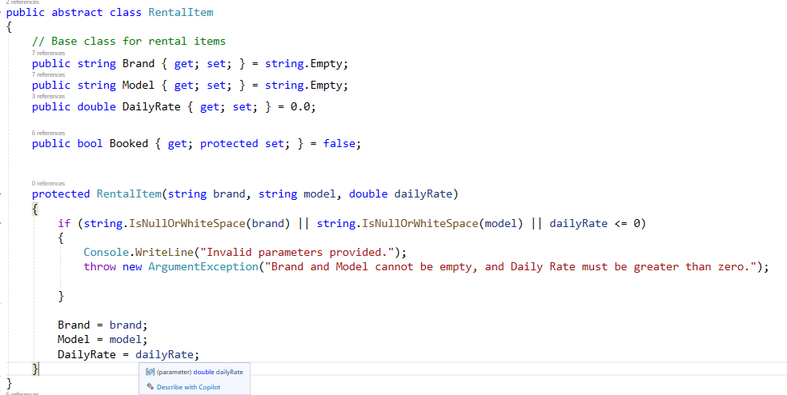

Slide 37
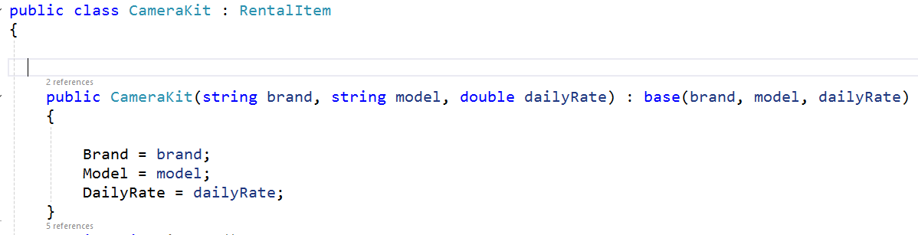
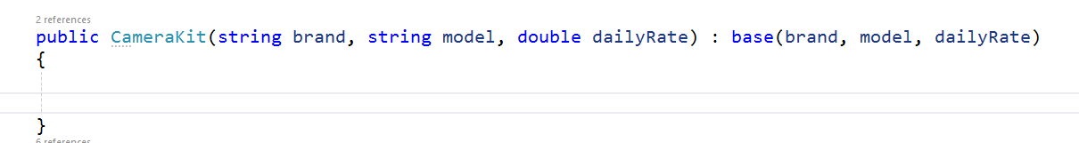
Constructors passes parameters back to base / abstract class
1
Removed original constructor
2
3

Slide 38
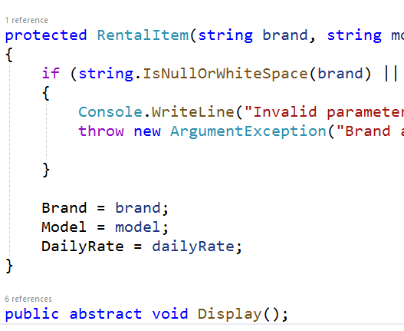
Position outside the constructor
Add this to the abstract class

Slide 39
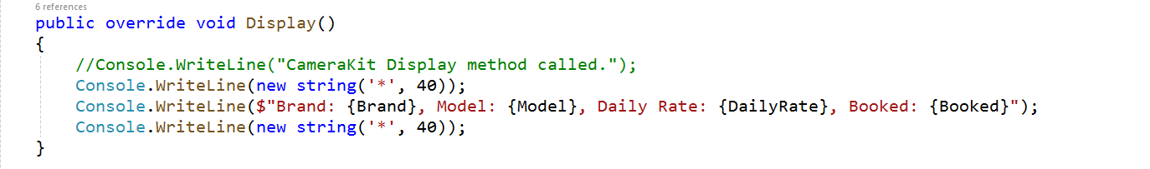
Modify this to implement abstract method from base class

Slide 40
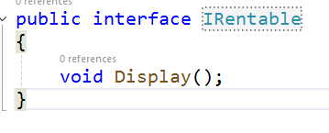
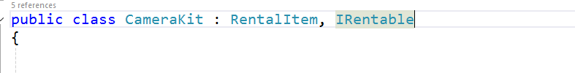

Slide 41
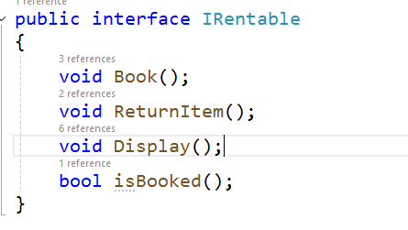
Interfaces, by convention, always start with an ‘I’
Think of an Interface as a ‘contract’ : when you apply IRentable to a class, you are obligated to implement those interface methods
Tip: If you have not implemented the methods, right clicking on the interface in VS will offer to create the methods

Slide 42
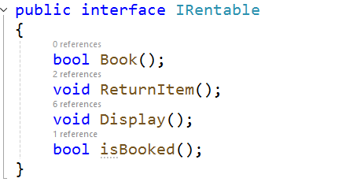
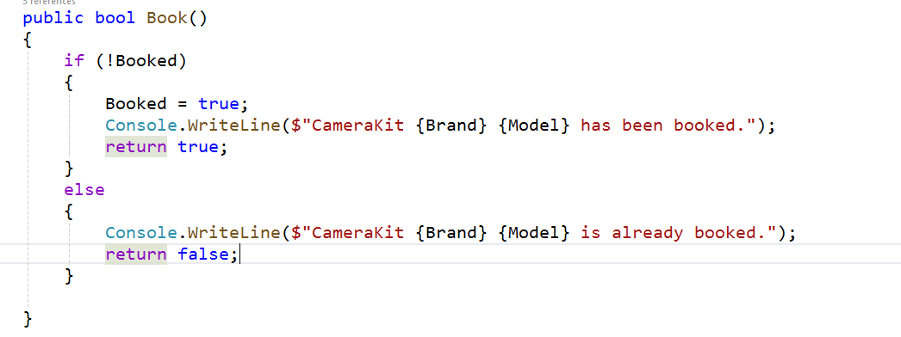
1
Modify Book to return a bool (true/false) and update the method with return declaration and return values
2
3
4

Slide 43
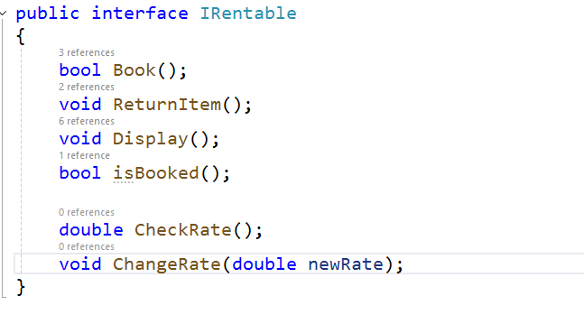
Add the two new methods but throw an ‘Not Implemented Exception’

Slide 44
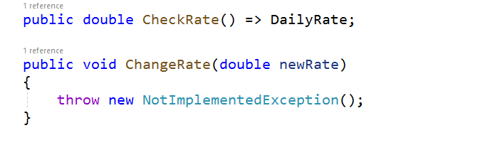

Slide 45


Slide 46

1
2

Slide 47



1
Constructor instantiation (initialising) needs to be updated
2
3

Slide 48


Initialise AssetTag and KitType and update Display method
1
2
3

Slide 49


Slide 50



Slide 51

Copy from driver
1
2
FACT – indicates it should be treated as a test
Test name indicates what is expected by the test
3
Assertions validate various items

Slide 52

1
2
Fix the failing tests

Slide 53

1
2

Slide 54


